Slide 1

Heart Disease Prediction
Tianlai Li (tl266@duke.edu)
Qiyuan Shen (qs31@duke.edu)
Zedian Shao (zs100@duke.edu)

Slide 2
Outline
Introduction
Data Visualization
Data Cleaning
Methods
Models
Naïve Bayes Classifier
Catboost
Ensembles
Conclusion

Slide 3


Introduction
There are about 65900 people die from heart disease each year in the US. (equals 1 in 4 deaths). It ranks first in the cause of death. (data is collected by center for disease control and prevention )

Slide 4
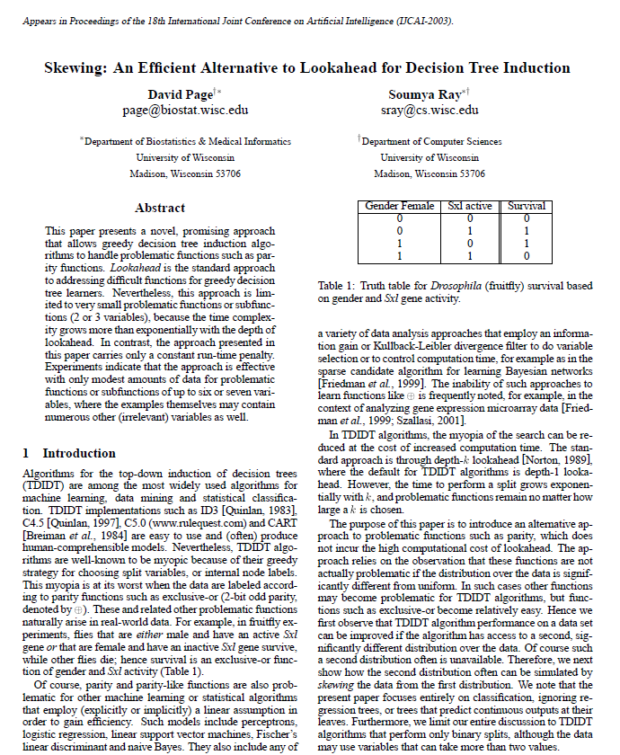
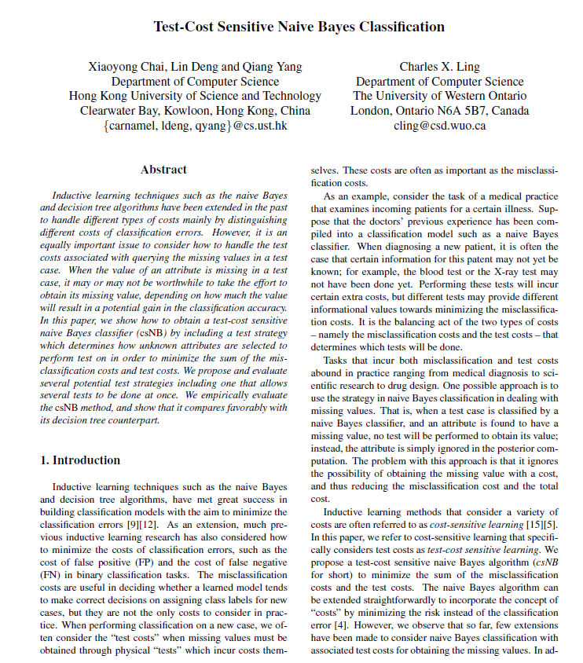
Introduction | literature review
Decision trees
Naïve bayes

Slide 5
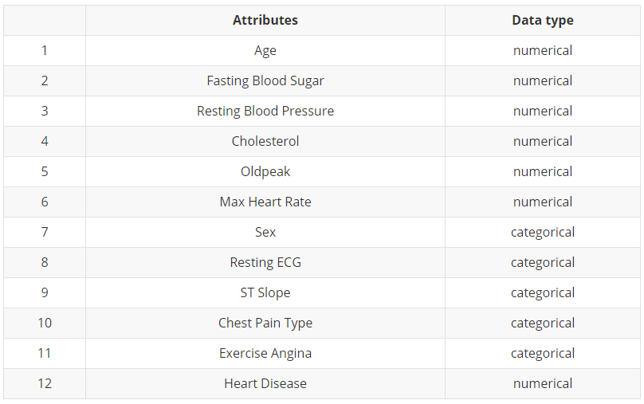

Dataset
12 attributes in total: 7 numerical & 5 categorical !

Slide 6
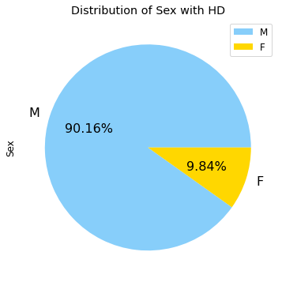
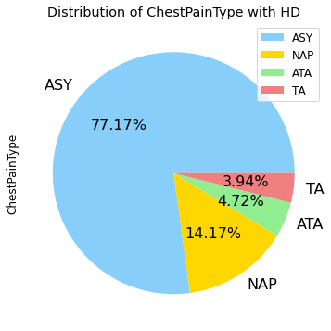
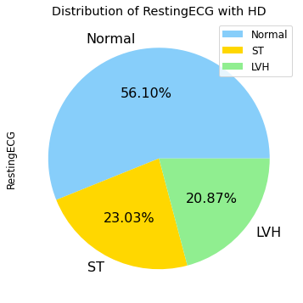
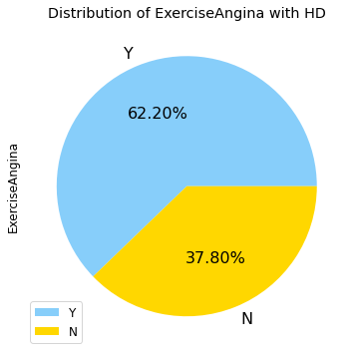
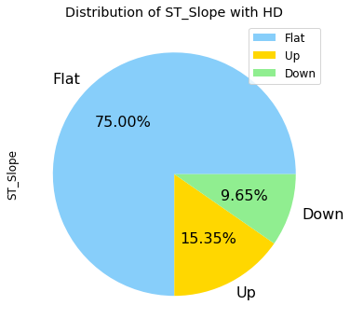
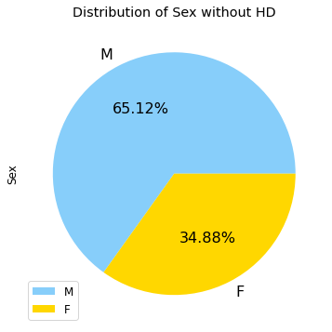
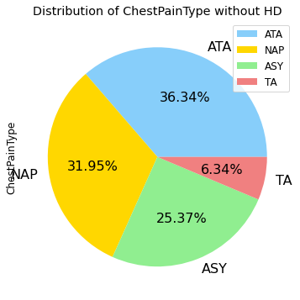
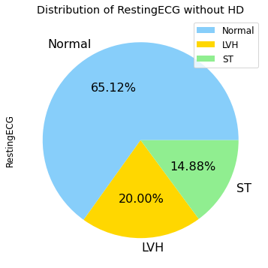
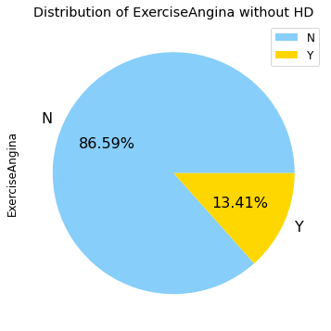
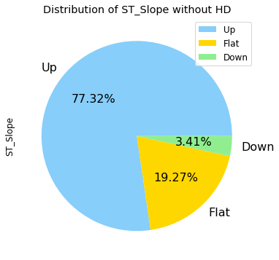
Visualization

Slide 7
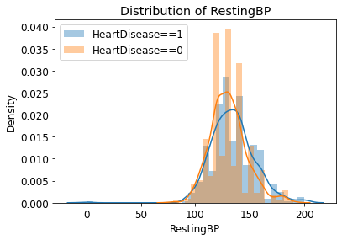
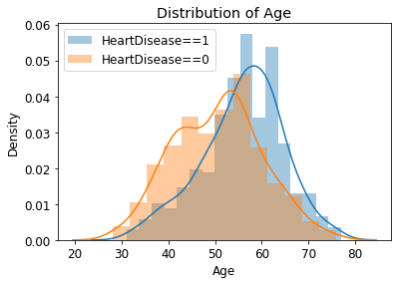
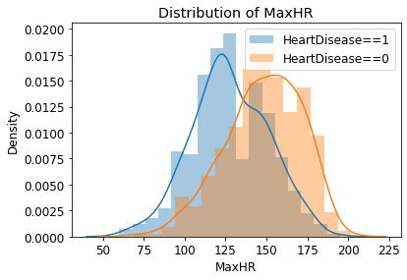
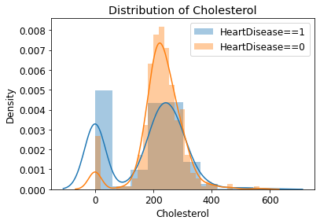
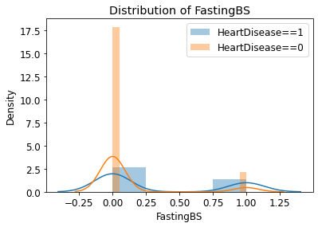
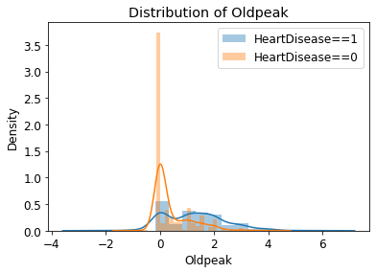
Visualization

Slide 8
Data Cleaning
Duplicates?
df.duplicated().sum() = 0
Missing values?
Categorical values
 | Missing_Number | Missing_Percent
Age | 0 | 0
Sex | 0 | 0
ChestPainType | 0 | 0
RestingBP | 0 | 0
Cholesterol | 0 | 0
FastingBS | 0 | 0
RestingECG | 0 | 0
MaxHR | 0 | 0
ExerciseAngina | 0 | 0
Oldpeak | 0 | 0
ST_Slope | 0 | 0
HeartDisease | 0 | 0
Sex | 2
ChestPainType | 4
RestingECG | 3
ExerciseAngina | 2
ST_Slope | 3
We have no duplicated entries and no missing values (null) in the data!

Slide 9
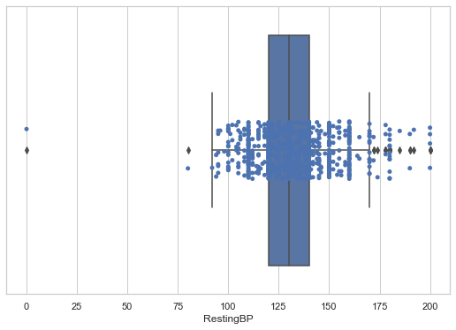
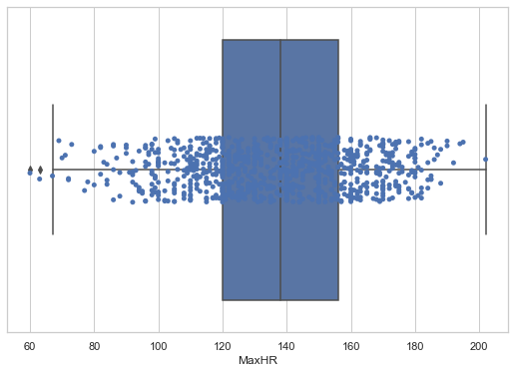
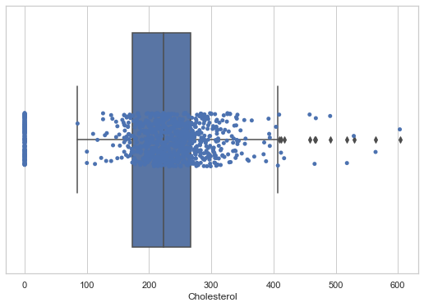
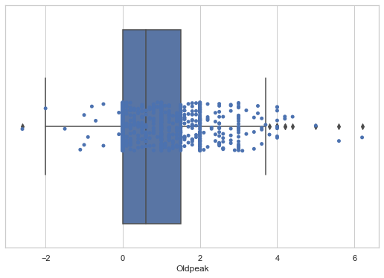

Data Cleaning
Outliers
Bound set:
Lower bound =
$P25−1.5∆$
Upper bound =
$P75+1.5∆$
$$∆=P75−P25$$

Slide 10

Naïve Bayes Classifier
A simple but powerful learning model
Dealing with categorical variables?
Just encoding! We select to use category_encoders.
Normalization?
Using RobustScaler !
Function?
Gaussian Naïve Bayes.

Slide 11
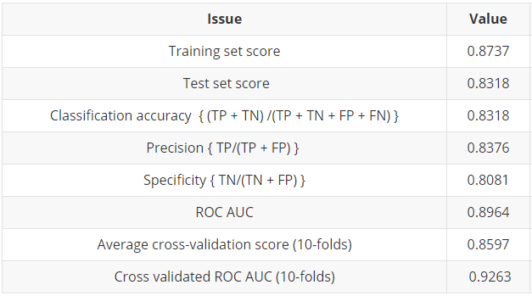
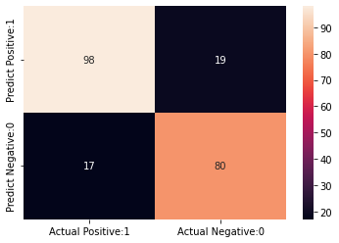
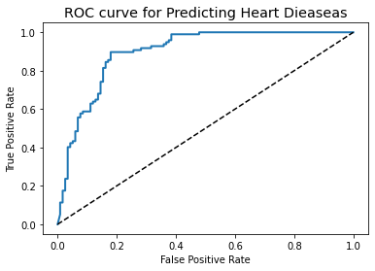
Naïve Bayes Classifier| results

Slide 12



Model | Catboost (Oblivious tree based)
Categorical $⇒$ Numerical
Categorical
Feature
Target
Statistics
Numerical
Features
Hyperparameter

Slide 13
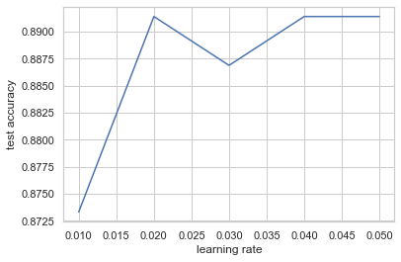
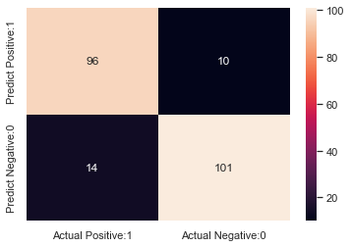
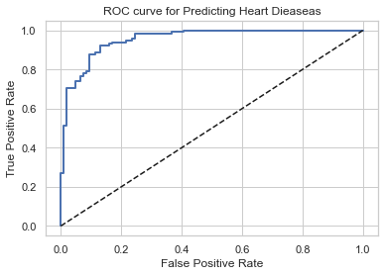
Model | Catboost (Oblivious tree based)
Categorical attributes: Sex, ChestPainType, FastingBS, RestingECG, ST_Slope, ExerciseAngina
Ordered boost: For every sample (random permutation) we generate a model and use this model to evaluate the gradient of the original sample.
Results:

Slide 14



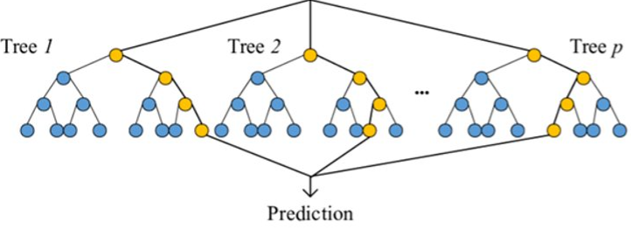
Ensembles| Gradient Boosting
Step 1: Determine the gradient of the loss function at the current position
Step 2: Get the descent distance by multiplying the learning rate α, which is
Step 3: Determine whether the descent distance is smaller than ε. If yes, return the result. Else, move forward.
Step 4: Update the θt with formula below:
Basic information about Gradient Boosting:
A boosting ensemble with regression trees.
Algorithm ideas:
Parameters: Model parameters: θ (θ0,θ1....θt)
Loss function: L(θ)
Learning rate: α
Error rate: ε

Slide 15
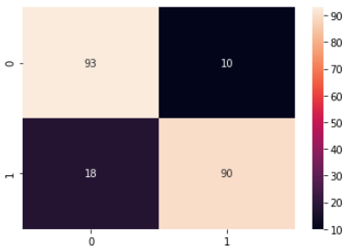
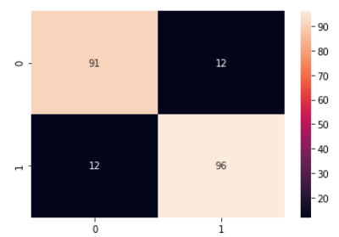
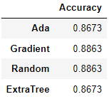
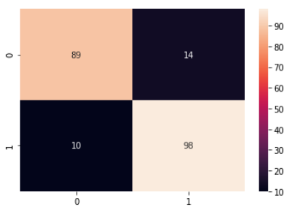
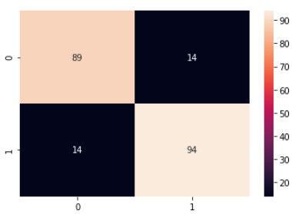
Ensembles| results
AdaBoost
GradientBoost
RandomForest
ExtraTree

Slide 16


Conclusion and discussion
Ensemble: best overall performance, longest running time
Naive bayes: worst performance, shortest running time
Generally, the method of Catboost is a better choice
Find a better model have a better accuracy
Conduct research based on the data of Chinese patient
Develop an algorithm that can give advice for the patient
Notes:
Conclusion:1. Ensemble: best overall performance, longest running time2. Naive bayes: worst performance, shortest running time3. Generally, the method of Catboost is a better choice

Slide 17
Reference
Prokhorenkova L, Gusev G, Vorobev A, et al. CatBoost: unbiased boosting with categorical features[J]. arXiv preprint arXiv:1706.09516, 2017.
Page D, Ray S. Skewing: An efficient alternative to lookahead for decision tree induction[C]//IJCAI. 2003: 601-612.
Chai X, Deng L, Yang Q, et al. Test-cost sensitive naive bayes classification[C]//Fourth IEEE International Conference on Data Mining (ICDM'04). IEEE, 2004: 51-58.
Data set: https://archive.ics.uci.edu/ml/datasets/Heart+Disease

Slide 18
Thanks for watching!

Slide 19


